Slide 1
Aviation Data
File created on: 11/9/2021 1:44:51 PM

Slide 2
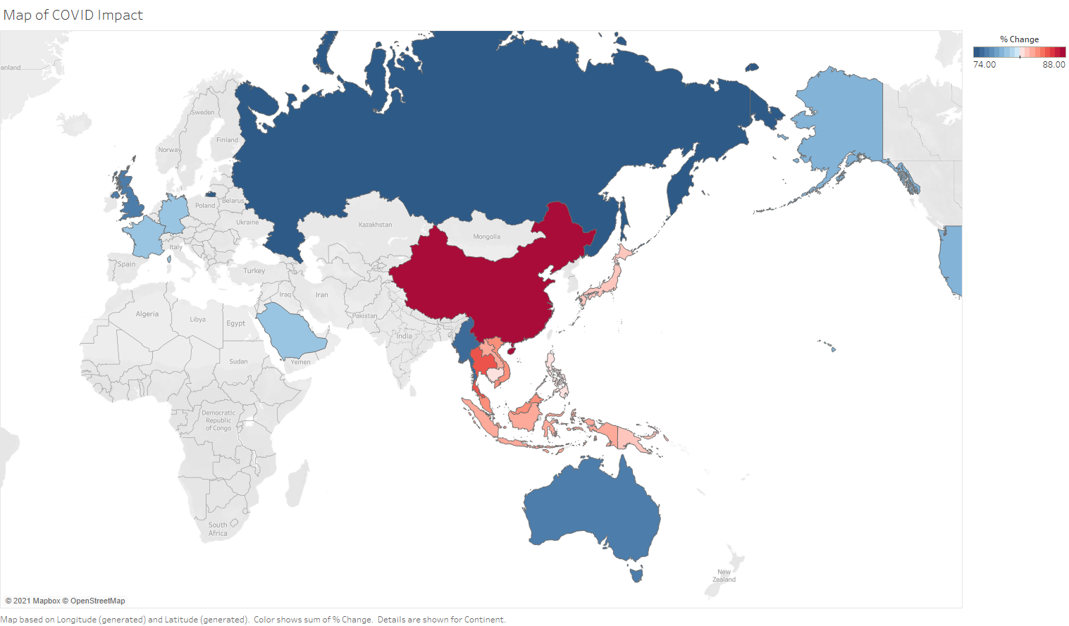

Slide 3
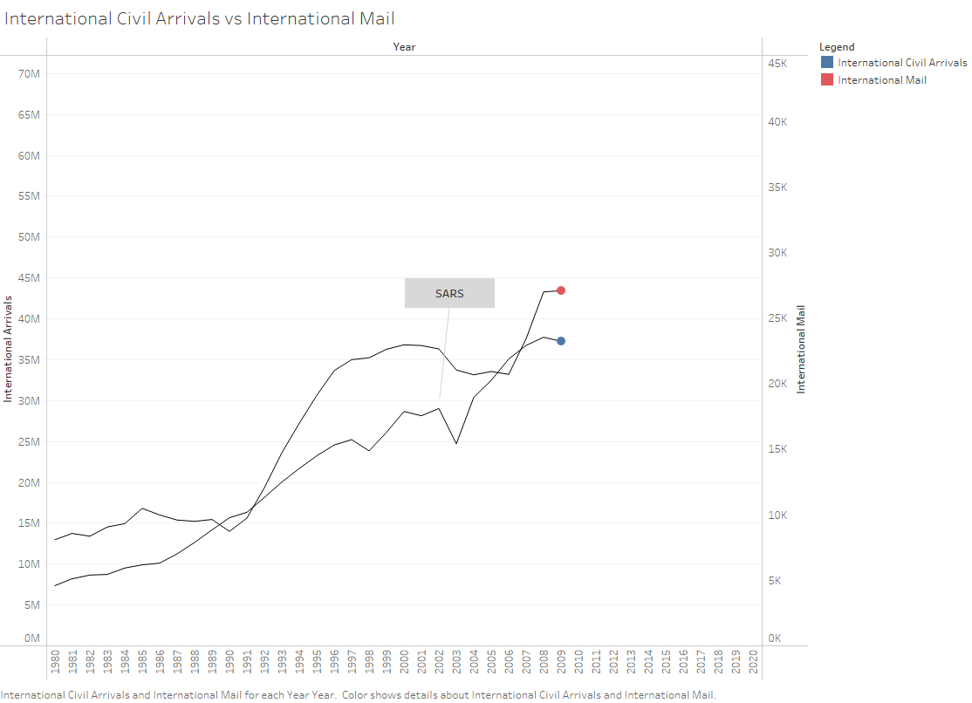

Slide 4
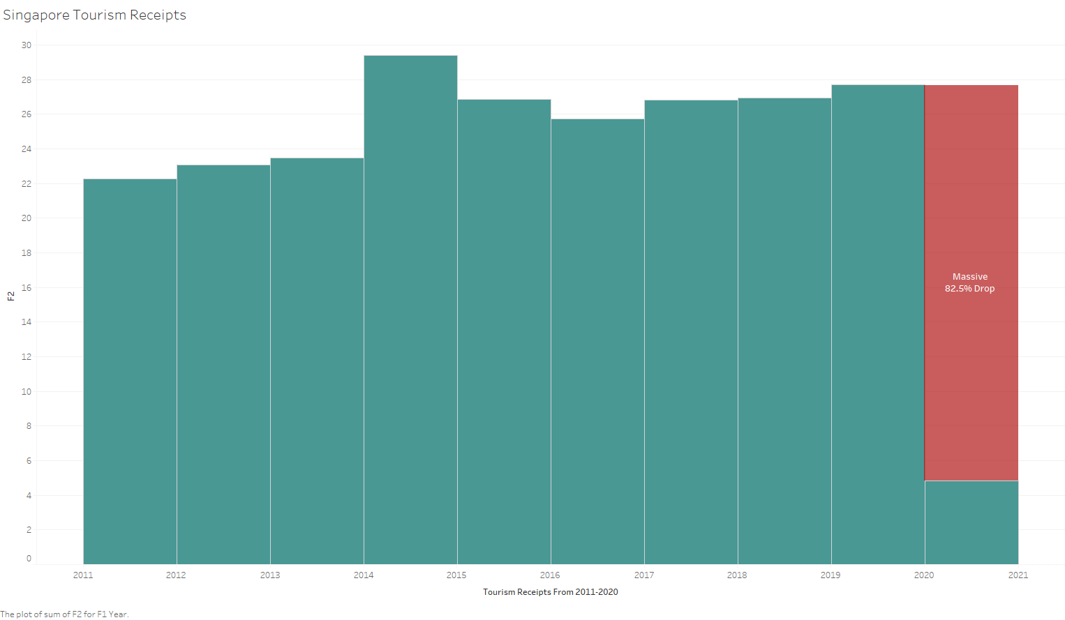

Slide 5
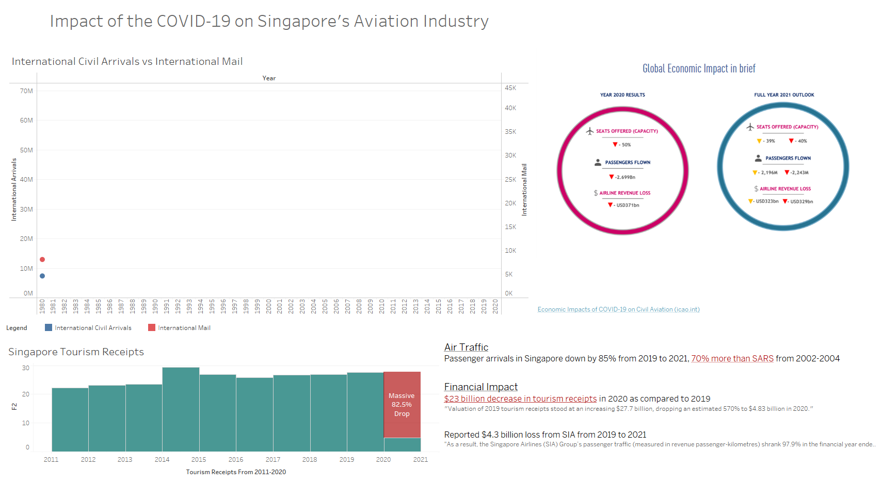

Slide 6
